Slide 1



Develop SCOPES template for your design challenge
TEAM MEMBERS : SANGAVI S (25ITR125)
SUMANTH S (25ITR146)
THIRUKUMARAN S (25ITR162)
YAZHINI S (25ITR180)
COURSE | : | 24ITL34 – DESIGN THINKING LAB
EXERCISE | : | 1
DATE | : | 22.07.2026

Slide 2
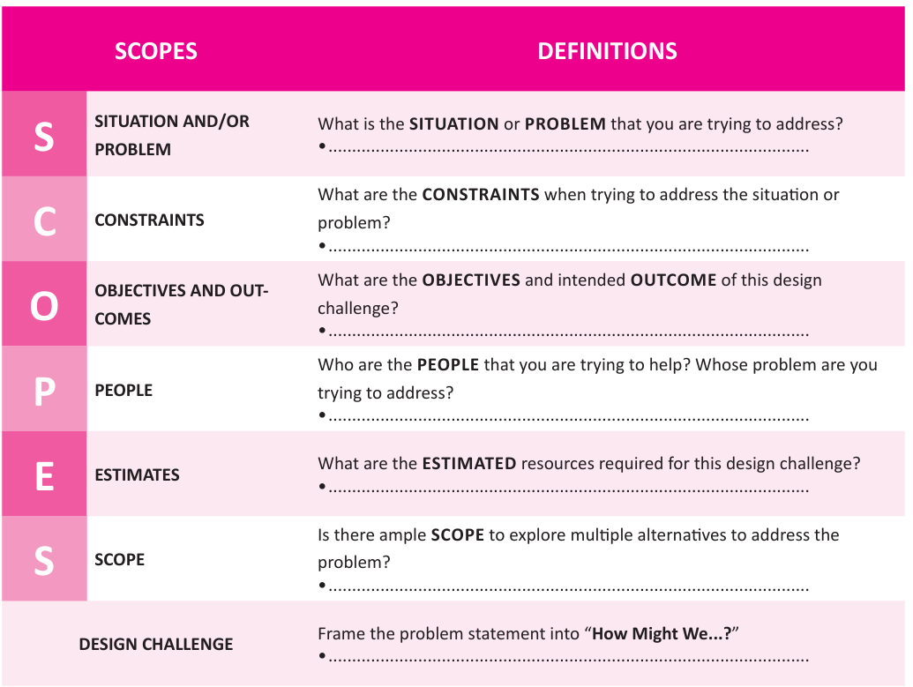
SCOPES Template

Slide 3
S – Situation / Problem
What are the constraints when trying to address the situation or problem ?
Limitations:
Requires a stable internet connection for real-time monitoring and alerts.
Camera and sensor performance may be affected by bad weather or poor lighting.
Power outages can interrupt the system unless a backup power source is available.
Assumptions:
The campus has reliable Wi-Fi or network connectivity.
Continuous power supply is available (or backup power is provided).
Students and staff carry mobile phones to receive emergency alerts.
Security personnel are available to respond immediately when an alert is triggered.
The system is installed at key locations across the campus.
3

Slide 4
C - Constraints
What is the situation or challenge that your trying to address ?
There is a lack of a real-time campus safety and emergency response system.
During emergencies such as medical incidents, harassment, theft, or accidents, students may not be able to quickly contact campus security, resulting in delayed assistance and increased safety risks.
4

Slide 5
O – Objectives & Outcomes
What are the objectives and intended outcome of this design challenge ?
Objectives:
To improve the safety and security of students, staff, and visitors on campus.
To provide a real-time emergency alert system through an SOS button, CCTV, and IoT sensors.
To enable quick communication between users and campus security for faster emergency response.
Expected Outcome:
Faster emergency response by immediately notifying security personnel during incidents . Enhanced campus safety through continuous monitoring and instant alerts . Reduced response time and increased confidence among students and staff, creating a safer campus environment.
5

Slide 6
P – People
Who are the people that you are trying to help? Whose problem are you trying to address Affected by this problem:
The problem mainly affects students, faculty, staff, visitors, campus security personnel, and the college administration. They require a safer campus environment with quick emergency response, better surveillance, and improved communication during accidents or security threats.
Target users:
Students – for quick access to help during emergencies, accidents, or harassment . Faculty and Staff – to ensure a safer working and learning environment . Campus Security Personnel – to receive instant alerts and respond quickly to incidents . Visitors – to access emergency assistance while on campus.
6

Slide 7
E – Estimates
What are the estimated resources required for this design challenge?
Time | 4–6 weeks to design, develop, test, and demonstrate the prototype.
Tools | Arduino / ESP32, Arduino IDE, laptop/computer, internet connection
Materials | CCTV camera , SOS push button, buzzer, LED light, microphone, speaker, motion/smoke sensor, Wi-Fi module, cables, power supply, pole/frame
Software | Arduino IDE, IoT platform (Blynk/ThingSpeak or similar), basic circuit design tools
Human Effort | Team of 4 students with guidance from faculty mentor
7

Slide 8
S – Scope
Is there sample scope to explore multiple alternatives to address the problem?
Develop a mobile safety app with an emergency SOS feature.
Install AI-powered smart CCTV cameras for automatic threat detection.
Use wearable emergency devices (smart bands or ID cards) with panic buttons.
Deploy IoT-based smart safety poles with sensors, cameras, and two-way communication.
Integrate drone surveillance for monitoring large campus areas during emergencies.
Potential for Further Exploration AI-based suspicious activity detection.
Face recognition for authorized access and security.
Solar-powered smart safety poles.
Integration with campus management systems and mobile notifications.
Predictive analytics to identify high-risk areas and improve campus safety.
8

Slide 9
Design Challenge
How might we improve campus safety by providing a smart, real-time emergency response system that enables students and staff to quickly alert security and receive immediate assistance?
9

Slide 10
Geo Tag Photos

Slide 11
Any photos

Slide 12
References
Research papers on expense-sharing algorithms.
Open-source libraries used.
https://www.tricount.com/
https://settleup.io/
12

Slide 13
Thank you!

